Slide 1



Channel analysis
Lets find out what channel gives you the best value for money!

Slide 2

Report overview
The objective of this project report is to provide stakeholders with clear insights about which advertising channel gives the best return on investment (ROI). We collected and analyzed traffic source data (provided by stakeholder) to understand performance across various channels. By using Python for the analysis and Excel for basic data cleaning, we gathered key metrics that highlights the effectiveness of each channel/medium. Various aspects like conversion rates, revenue generation, cost of acquisition etc. were analyzed.
This report’s primary goal is to identify the best-performing channels, allowing the optimize ad campaign to get more returns out of little investments. Ultimately, we want to help our client optimize their advertising strategy, improve eCommerce conversion rates, and ensure that their ad spend translates into meaningful revenue. At the end of this report, you will be able to identify which channel got the highest conversion rates, most revenue etc.

Slide 3
A brief about the data
The dataset comprises traffic source data, featuring 50 distinct channels. It includes 10 key metrics that provide insights into user behavior, session performance, and overall revenue generation.
The key columns are as follows:
Source/Medium: Represents the traffic source, showing where the users originate from.
Users: The total number of users from each source.
New Users: First-time visitors to the site.
Sessions: The total number of sessions initiated from the traffic source.
Bounce Rate: Percentage of single-page sessions (where users leave without interacting further).
Pages / Session: Average number of pages viewed per session.
Avg. Session Duration: The average time spent per session (in seconds).
Ecommerce Conversion Rate: Percentage of sessions that resulted in a transaction.
Transactions: Total number of transactions completed.
Revenue: Total revenue generated by each source.
Additional metric columns like new user percentage, converted users, revenue gained per customer, transaction volume, sessions per user and revenue gained per transaction were created for better analysis.
Note: The currency is assumed to be in USD.

Slide 4
Key metrics
Let us understand in brief about the key metrics that were created from existing variables.
New user percentage: This metric depicts what percentage of users are new. It is necessary as it shows the channel’s ability to get engagement which is critical for scaling and market growth.
Converted users: This metric depicts how many users are converted to customers. This lets us know how many users make purchases and lets us know a channel’s marketing effectiveness.
Revenue per customer: This metric lets us know the amount spent by each customer on a channel. This metric will help us classify which channel gets us more high paying clients and ultimately profitability of a channel.
Revenue per transaction: We can understand via this metric the amount spent per transaction on a channel. It is vital for understanding the average value of each sale generated through a particular traffic source. It helps evaluate which channels are driving high-value transactions, allowing for more targeted ad spend allocation.
Sessions per user: This metric shows how many sessions, on average, each user initiates. It helps measure user engagement, indicating which channels bring users that return more frequently. More sessions per user can suggest a more engaged audience.
Transaction volume: This metric calculates the number of transactions generated per session. A higher transaction volume means a channel is not only attracting traffic but is also effective in generating frequent purchases per session.

Slide 5
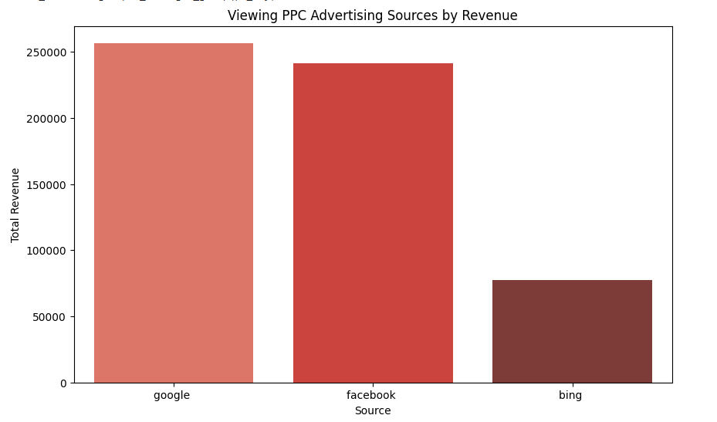
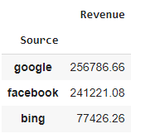
Pay-per-click source revenue analysis
Question: Which pay-per-click advertising source drove the most revenue?
Answer: Google generated the most revenue followed by Facebook and Bing.

Slide 6
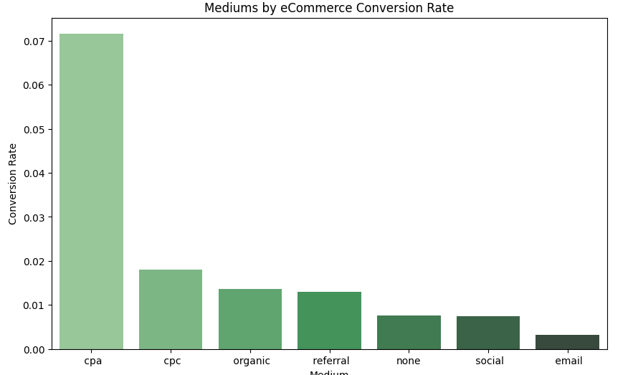
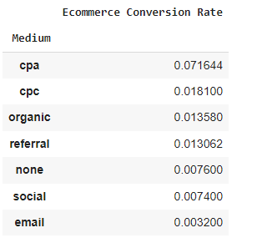
Medium conversion rate analysis
Question: Which medium has the highest eCommerce conversion rate?
Answer: CPA medium has the highest conversion rate followed by CPC and organic.

Slide 7
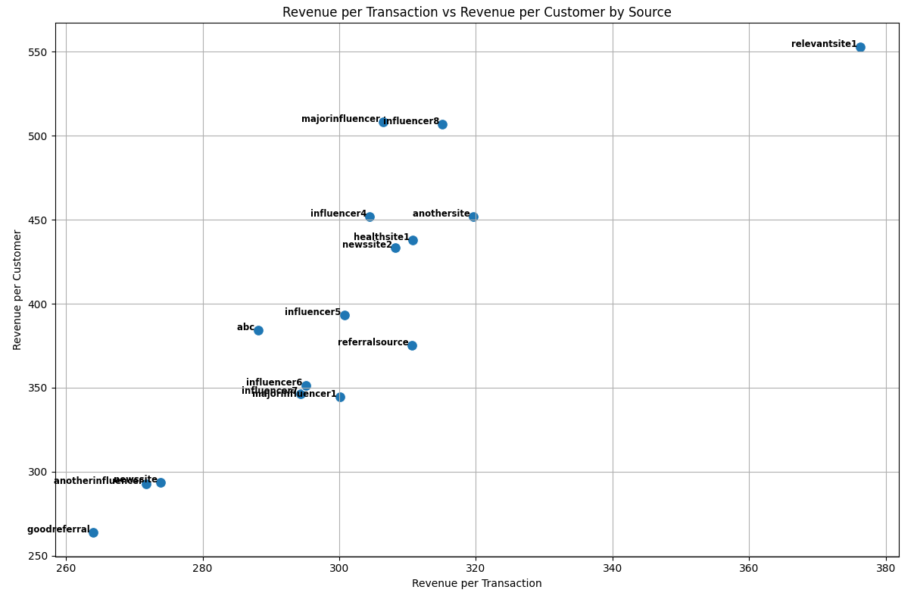
CPA medium analysis
Question:If all of the users from the CPA medium are being paid for, are there any sources that you would stop? Are there any that you would spend more money on (assuming you could)?
Answer: To answer this question, a subset was created where only sources with CPA medium were there. Then two metrics namely- revenue per transaction and revenue per customer were selected for the analysis. The sources were plotted on the graph. The top source that performed best on both parameters was relevantsite1 while goodreferral performed the worst (ironically). I would spend more money on relevantsite1,majorinfluencer and influencer8 while I would cease spending on goodreferral,newssite and anotherinfluencer.

Slide 8

Observations based on engagement metric analysis
Sources like goodsite1, goodreferral, t.co, smartnews and influencersite.jp and mediums like none,cpc and organic have high new user percentages.On the other hand, sources like newssite2,relevantsite1 and retailmenot.com have a lower new user percentage along with cpa medium.
Android app is the source and email is the medium that have most sessions per user while Social medium and sources like Instagram, goodsite, anothersite have less sessions per user.
Sources like influencer8,influencersite.com and rewardsite while cpa medium have more pages viewed per session. While sources like smartnews and goodsite1 along with email have less page views per session.
Highest session duration which means more time spent per session is via influencer8 and organic medium. And social medium and sources like goodsite1and smartnews have lowest time spent per session.
Sources like goodsite, smartnews and referralsource and cpa medium have the highest bounce rates while email medium and rewardsite source have lowest bounce rates.

Slide 9

Observations based on Revenue metric analysis
Sources like direct and google are the only ones bringing significant revenue while medium none is the one bringing most revenue. Mediums like organic and cpc are decent.
If we speak about revenue per user, cpc medium and sources like google, newssite3, android and ios apps are brining highest revenue per user. On the other hand, sources like goodsite1, rewardsite and smartsnews and medium like cpa generate least revenue.
Sources like reddit,influencersite and google have highest revenue on a per transaction basis while sources like goodsite1,rewardssite and smartnews have lowest value per transaction. Medium cpc and cpa generate the highest and lowest value per transaction respectively.
Medium email has the lowest conversion rate and cpa has the highest conversion rate. Sources like Influencer8 are driving the highest conversion rate along with likes of anothersite,newssite2, influencer4.Sources like rewardsite,goodsite1,Instagram,smartnews and klaviyo have lowest conversion rates.
Sources like google and direct have the highest transaction volume alongside None medium. Mediums like cpc and organic do a decent job while other medium disappoint us here in this metric. Other sources besides those two don’t bring any significant transaction volume.

Slide 10

Recommendations to the stakeholder
Based on the observations I will make the following recommendations based on various aspects.
Prioritize High-Performing Channels:Increase investment in Google, Direct, and None mediums, which generate the most revenue and transactions.Continue focusing on CPC campaigns, as they drive high revenue per user and per transaction.
Optimize Underperforming Channels:Re-evaluate or adjust strategies for goodsite1, smartnews, and rewardsite, which have low revenue per user and conversion rates.
Review the CPA medium, which has a high conversion rate but low revenue per transaction.
Enhance Engagement on Social Channels:Improve engagement on Instagram, anothersite, and goodsite by offering richer content like videos and interactive posts.For smartnews and goodsite1, optimize landing pages and user experience to increase session duration and page views.
Boost Email Conversion Rate:Refine the email medium strategy by personalizing offers and improving segmentation to drive more conversions.Capitalize on High-Engagement Channels:Leverage Influencer8 and the organic medium with targeted campaigns to convert their higher engagement into sales.
Reduce Bounce Rates:Lower bounce rates on goodsite1, smartnews, and the CPA medium by improving page relevance, speed, and design.

